Slide 1
A Neural Probabilistic
Language Model
12.12.20

Slide 2


Abstract
Statistical Language Model
- Joint probability function of sequences
/P
1) Curse of Dimensionality e.g., free parameters
2) Sparsity problem
N-gram Language Model
Generalization by concatenating very short overlapping sequences
Exponential number of Semantic & Syntactic similarities
Model
1) Back-off n-gram model : 1. if sparsity: (n)gram -> (n-1)gram 2. w*P()
2) Interpolated model n-gram model : Linear Combination[Lamda*each(n-gram)]

Slide 3
Neural Probabilistic LM
Distributed Representations (분산표산)
Low features
Word feature vector (vector-space representation)
: a product of conditional probabilities (Table)
e.g. a multi-layer neural network
Parameters for Max(log-likelihood of the training data)
e.g. weight decay penalty
-> Similarities to obtain generalization from training set to new

Slide 4



Neural Probabilistic LM
Neural Model
Joint Probability of sequences
Shared parameter multi-layer neural networks
High out-of-sample likelihood
Perplexity
: the exponential of the average negative log-likelihood
(Constraint) f >0,

Slide 5
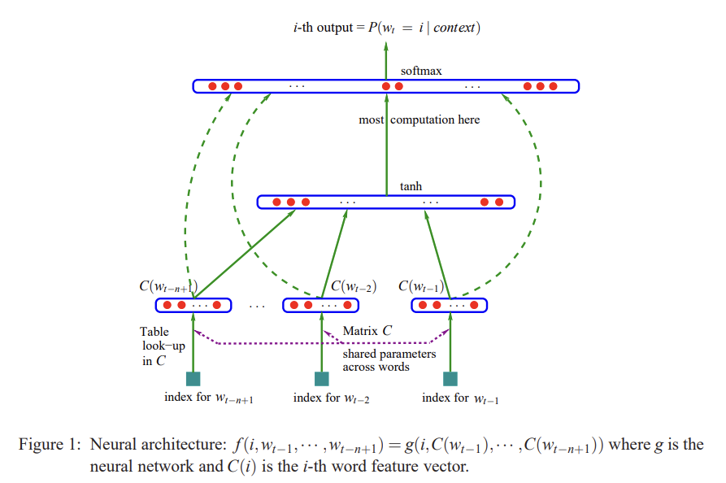
Neural Probabilistic LM
Step 1 : Input data
# mapping C
: distributed feature vectors
: a lVl x m matrix of free-paramaters
# g maps
: Input sequence of feature vectors to a conditional probability distribution w/ parameter w
- overall parameter 8 = (C,w)
# F function
: composition of (C & g) w/ parameters(C, w)

Slide 6


Neural Probabilistic LM
Step 2 : Training data
max(training corpus penalized log-likelihood) by looking for parameters 8
R(parameter 8) : weight decay penalty
Step 3 : Hidden data
1. Layer C : shared word features, no non-linearity
2. Ordinary hyperbolic tangent hidden layer
- compute w/ softmax output layer

Slide 7

Neural Probabilistic LM
Step 4 : Output
Unnormalized log-probabilities for each output
[parameters]
- b : output biases w/ lVl
- d : hidden layer biases w/ hidden units h
- U : hidden-to-output weights (a |V| ×h matrix)
- W : word feature to output weights (a |V|*(n−1)m matrix)
- H : hidden layer weights (a h × (n − 1)m matrix),
- C : word features (a |V| ×m matrix)
- n(free parameters)
|V|(1 + nm + h) + h(1 + (n − 1)m)

Slide 8
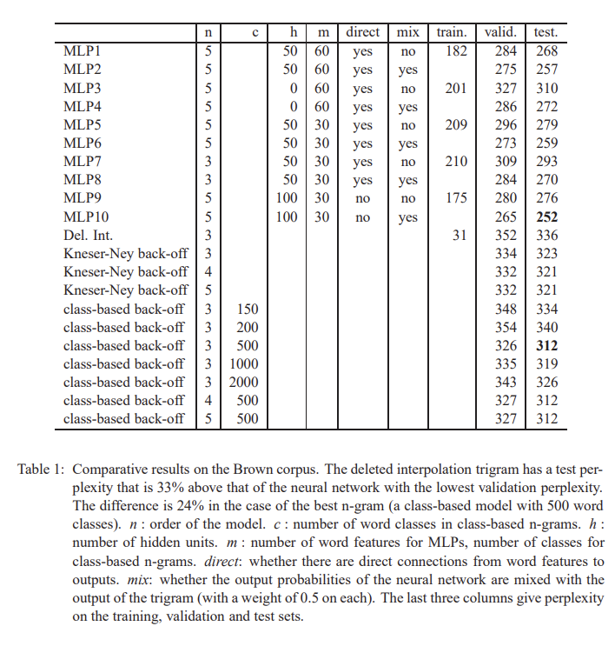
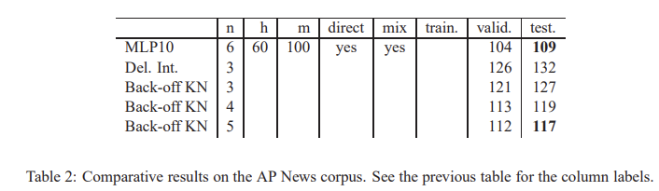
Results
Measure [Perplexity]
geometric average of 1/Pˆ(wt |wt−1 1 ))

Slide 9
Conclusions
Conclusions
Curse of dimensionality -> Distributed representation
Computational efficiency using prior knowledge
Improve statistical LM by Lookup table
hidden units are useful > input to output
NN w/ interpolated trigram reduces perplexity
on smaller corpus, better generalization.

